Slide 1
Modul 5b XML
Session 1, 11-11-2020
Dr. Jaap Geraerts
Notes:
1

Slide 2
Course overview
First session
XML basics (elements and attributes)
DTD and schema
Oxygen (XML Editor)
Hands-on session: encoding
Second session
Transforming XML (XSLT)
Querying XML
XML and metadata
Third session
Publishing XML
Linked Open Data/Semantic Web
Notes:
2

Slide 3
Learning outcomes
What:
Learning the basics of XML
Learning how to query, transform and publish XML
Learning the relation between XML and Linked Open Data
How:
Presentations (theoretical reflections)
In-class exercises, hands-on sessions, homework
Self-study!!
Why:
Understanding XML and related technologies
Understanding the relation between XML and scholarly goals and aims
Notes:
3

Slide 4
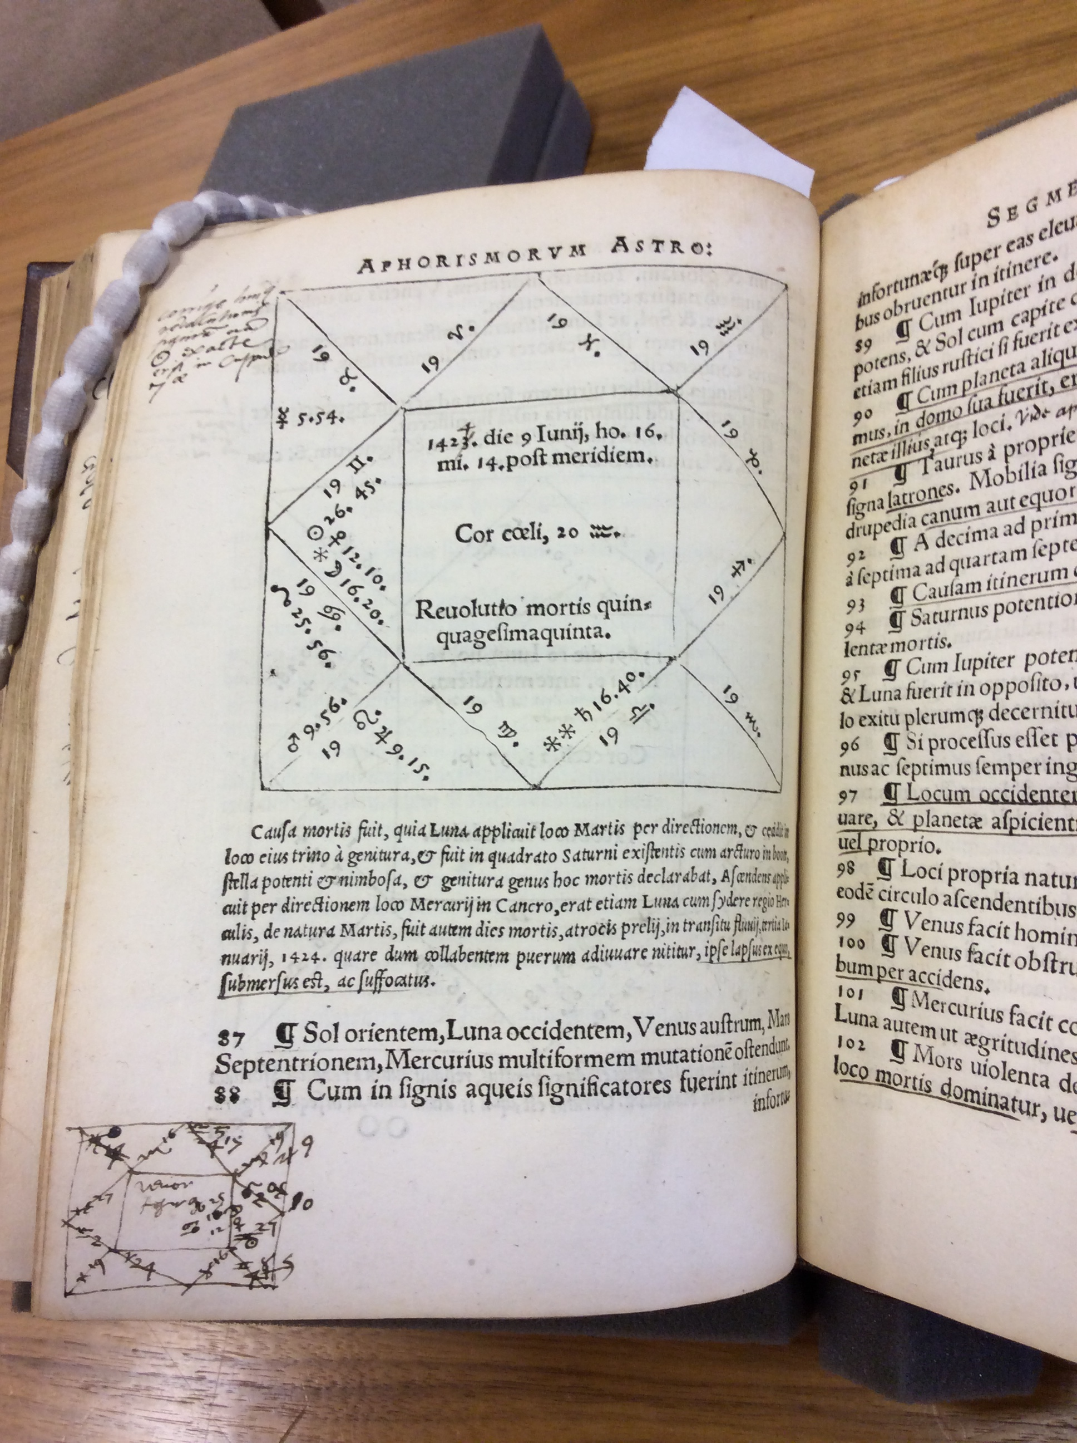
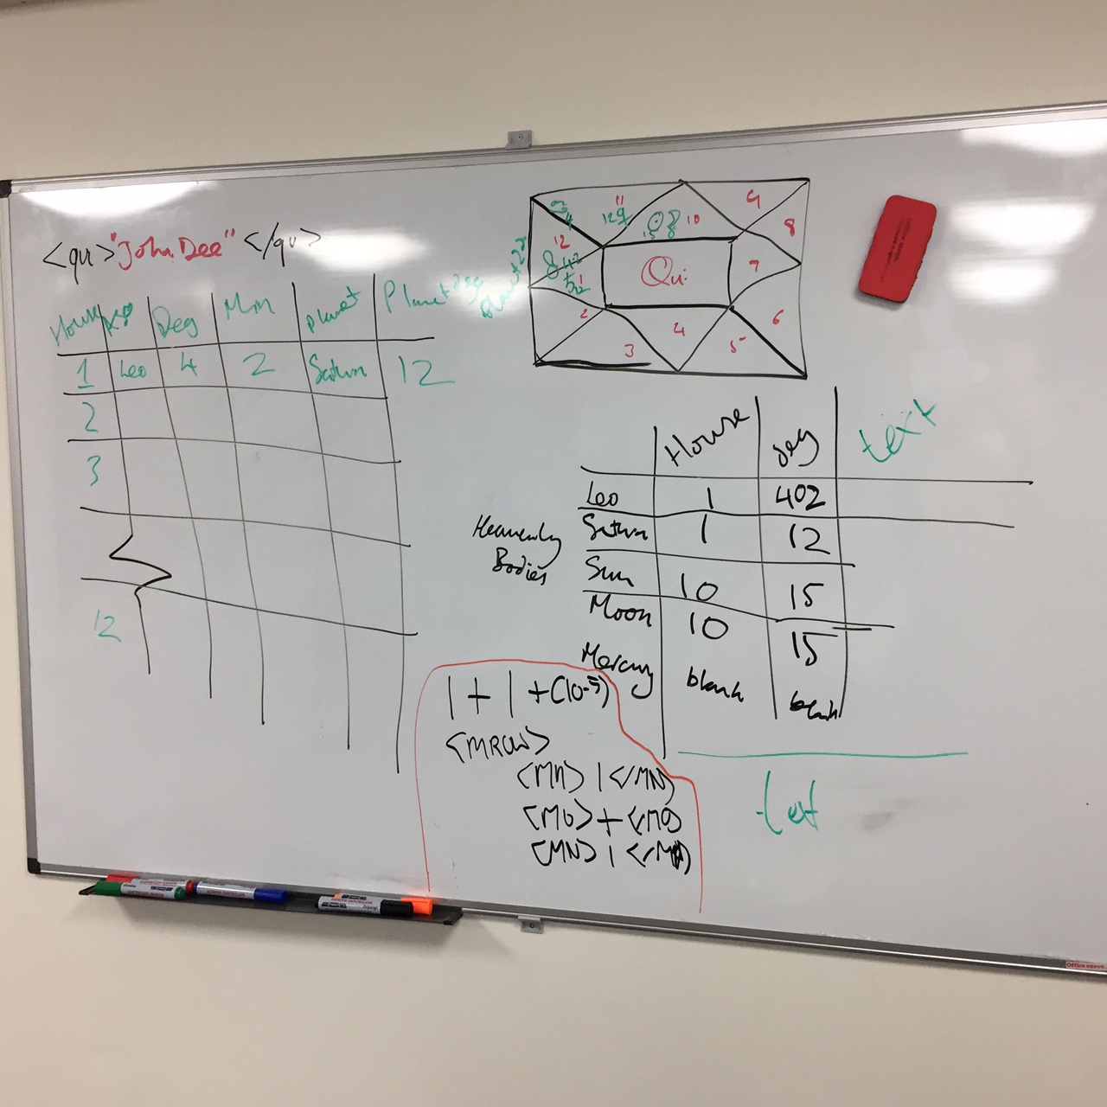
<!ELEMENT table (tr*, table_text*, table_person*, table_book*,
table_location*, table_symbol*, table_text_translation?)> <!ATTLIST table type (astrological_chart|standard_table) #REQUIRED> <!ATTLIST table place (head|tail|left_margin|right_margin|intext|full_page) #REQUIRED> <!ATTLIST table id CDATA #IMPLIED> <!--functions as ID--> <!ATTLIST table internal_link CDATA #IMPLIED> <!--functions as IDREFS--> <!ATTLIST table aggregated_information CDATA #IMPLIED> <!ELEMENT tr (th*, td*)> <!ELEMENT th (#PCDATA)> <!ATTLIST th label CDATA #IMPLIED> <!ATTLIST th anchor_text CDATA #IMPLIED> <!ATTLIST th anchor_data CDATA #IMPLIED> <!ELEMENT td (#PCDATA)> <!ATTLIST td anchor_text CDATA #IMPLIED> <!ATTLIST td anchor_data CDATA #IMPLIED> <!ELEMENT table_text (#PCDATA)>
Notes:
4

Slide 5
A brief history of XML
eXtensible Markup Language
Developed in the mid-1990s
HTML: focus on capturing “presentation layers”
Standerdized General Markup Language: very technical
XML as alternative for SGML
Describing and capturing data
Data exchange & creation of structured data

Slide 6
Elements and Attributes (1)
Elements: the main building blocks of XML
Elements: describe and contain particular data
Attributes: define properties of elements (metadata)
Example:
<recipe>
<recipe name =‘’>

Slide 7
Elements and Attributes (2)
<recipe> This is the recipe to make apple pie. One needs the following ingredients. Start with peeling the apples…
</recipe>
<recipe name=‘Apple Pie’> One needs the following ingredients. Start with peeling the apples…
</recipe>

Slide 8
Elements and Attributes (3)
<recipe name=‘Apple Pie’ ingredient=‘apples’>
Start with peeling the apples…
</recipe>
<recipe name=‘Apple Pie’ ingredients=‘apples; sugar; flour’>
Start with peeling the apples…
</recipe>

Slide 9
Elements and Attributes (4)
<recipe name=‘Apple Pie’>
<ingredient name = ‘Apple’ type = ‘Goudreinet’/>
<ingredient name =‘Sugar’ type = ‘Brown sugar’/>
<instructions>Start with peeling the apples…</instructions>
</recipe>

Slide 10
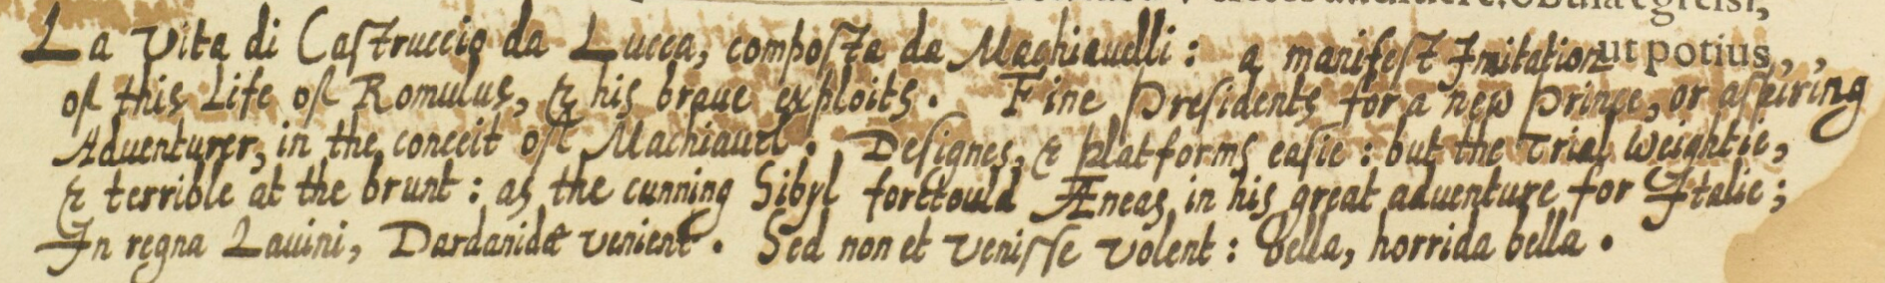
<marginalia hand="Italian"> <language ident="IT"> <position place="tail" book_orientation="0"> <marginalia_text>La vita di Castruccio da Lucca, composta da Machiauelli:</marginalia_text> <person name="Machiavelli"/> <book title="La vita di Castruccio Castracani"/> </position> </language> <language ident="EN"> <position place="tail" book_orientation="0"> <marginalia_text>a manifest Imitation of this Life of Romulus, &amp; his braue exploits. Fine Presidents for a new Prince, or aspiring Aduenturer, in the conceit of Machiauel. Designes, &amp; platforms easie: but the Trial weightie, &amp; terrible at the brunt: as the cunning Sibyl foretould A[e]neas, in his great aduenture for Italie;</marginalia_text> <person name="Romulus"/> <person name="Machiavelli"/> <person name="Aeneas"/> <person name="Cumaean Sibyl"/> <X-ref person="Virgil" book_title="Aeneid"/>

Slide 11

XML DTD & Schema
Document Type Definition
<!ELEMENT cookbook (recipe+)> <!ELEMENT recipe (ingredients+, instructions)> <!ATTLIST recipe name CDATA #REQUIRED> <!ELEMENT ingredients EMPTY> <!ATTLIST ingredients name CDATA #REQUIRED> <!ATTLIST ingredients type CDATA #IMPLIED> <!ELEMENT instructions (#PCDATA)>

Slide 12
<xs:schema xmlns:xs="http://www.w3.org/2001/XMLSchema" elementFormDefault="qualified"> <xs:element name="cookbook"> <xs:complexType> <xs:sequence> <xs:element maxOccurs="unbounded" ref="recipe"/> </xs:sequence> </xs:complexType> </xs:element> <xs:element name="recipe"> <xs:complexType> <xs:sequence> <xs:element maxOccurs="unbounded" ref="ingredients"/> <xs:element ref="instructions"/> </xs:sequence> <xs:attributeGroup ref="attlist.recipe"/> </xs:complexType> </xs:element> <xs:attributeGroup name="attlist.recipe"> <xs:attribute name="name" use="required"/> </xs:attributeGroup> <xs:element name="ingredients"> <xs:complexType> <xs:attributeGroup ref="attlist.ingredients"/> </xs:complexType> </xs:element> <xs:attributeGroup name="attlist.ingredients"> <xs:attribute name="name" use="required"/> <xs:attribute name="type"/> </xs:attributeGroup> <xs:element name="instructions" type="xs:string"/> </xs:schema>

Slide 13
<xs:schema xmlns:xs="http://www.w3.org/2001/XMLSchema" elementFormDefault="qualified"> <xs:element name="recipe"> <xs:complexType> <xs:sequence> <xs:element maxOccurs="unbounded" ref="ingredients"/> <xs:element ref="instructions"/> </xs:sequence> <xs:attributeGroup ref="attlist.recipe"/> </xs:complexType> </xs:element> <xs:attributeGroup name="attlist.recipe"> <xs:attribute name="name" use="required"/> </xs:attributeGroup> <xs:element name="ingredients"> <xs:complexType> <xs:attributeGroup ref="attlist.ingredients"/> </xs:complexType> </xs:element> <xs:attributeGroup name="attlist.ingredients"> <xs:attribute name="name" use="required"/> <xs:attribute name="type"/> </xs:attributeGroup> <xs:element name="instructions" type="xs:string"/> </xs:schema>
Standard XML declaration
Root element
Complex: has attributes and contains various
child elements
Sequence of child elements
Specifies list of attributes
belonging to ‘recipe’ element
Specifies name of attributes
and its properties
Type specifies predifined data type
Always make sure to close all elements and attributes!
Notes:
13

Slide 14
Ref attribute
Use the ref attribute to divide the schema and make it more readable and to declare global elements and attributes
Click here for an example (WWW3C)
<xs:schema xmlns:xs="http://www.w3.org/2001/XMLSchema">
<xs:attribute name="name" />
<xs:element name="recipe"> <xs:complexType> <xs:sequence> <xs:element maxOccurs="unbounded" ref="ingredients"/> <xs:element ref="instructions"/> </xs:sequence> <xs:attributeGroup ref="attlist.recipe"/> </xs:complexType> </xs:element> <xs:attributeGroup name="attlist.recipe"> <xs:attribute ref="name" use="required"/> </xs:attributeGroup> <xs:element name="ingredients"> <xs:complexType> <xs:attributeGroup ref="attlist.ingredients"/> </xs:complexType> </xs:element> <xs:attributeGroup name="attlist.ingredients"> <xs:attribute ref="name" use="required"/> <xs:attribute name="type"/> </xs:attributeGroup> <xs:element name="instructions" type="xs:string"/> </xs:schema>
<xs:schema xmlns:xs="http://www.w3.org/2001/XMLSchema"> <xs:element name="recipe"> <xs:complexType> <xs:sequence> <xs:element maxOccurs="unbounded" ref="ingredients"/> <xs:element ref="instructions"/> </xs:sequence> <xs:attributeGroup ref="attlist.recipe"/> </xs:complexType> </xs:element> <xs:attributeGroup name="attlist.recipe"> <xs:attribute name="name" use="required"/> </xs:attributeGroup> <xs:element name="ingredients"> <xs:complexType> <xs:attributeGroup ref="attlist.ingredients"/> </xs:complexType> </xs:element> <xs:attributeGroup name="attlist.ingredients"> <xs:attribute name="name" use="required"/> <xs:attribute name="type"/> </xs:attributeGroup> <xs:element name="instructions" type="xs:string"/> </xs:schema>
Notes:
14

Slide 15
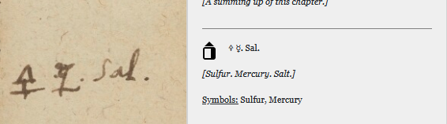
Entities
Entities: use them to create shortcuts to special characters
Click here for an example of a predifined list
<!ENTITY Sulfur "&#128781;"> <!-- &#128781; = Unicode -->
<marginalia_text>&Sulfur; &Mercury;. Sal.</marginalia_text>

Slide 16
Structure of XML files
XML files (usually) start with a declaration, e.g. <?xml version="1.0" encoding="UTF-8"?>
References to (external) DTD and/or schema: <Cookbook xmlns:xsi="http://www.w3.org/2001/XMLSchema-instance" xsi:noNamespaceSchemaLocation="C:\Users\jgeraert\Desktop\recipe.xsd">

Slide 17
Sources
https://www.w3schools.com/xml/
https://beginnersbook.com/2018/10/xml-tutorial-learn-xml/
https://archaeologyofreading.org/wp-content/uploads/sites/21/2019/04/AOR2_Transcribers_Manual_29012019.pdf

